Slide 1

Contact me!
But how?
By: Daravy DeRouen

Slide 2
WHY A RESPONSIVE CONTACT FORM?
A WAY TO CONNECT WITH YOUR USER
ANOTHER METHOD OF KEEPING YOUR PRIVACY
SIMPLE & QUICK TO IMPLEMENT!

Slide 3
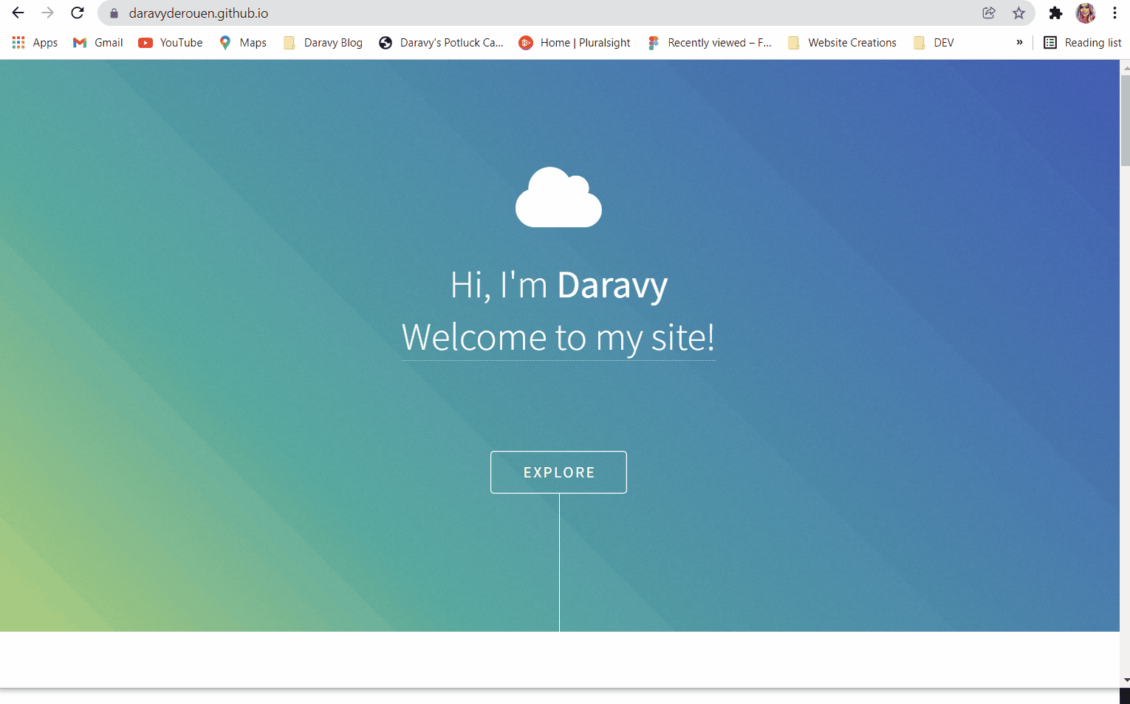

Slide 4
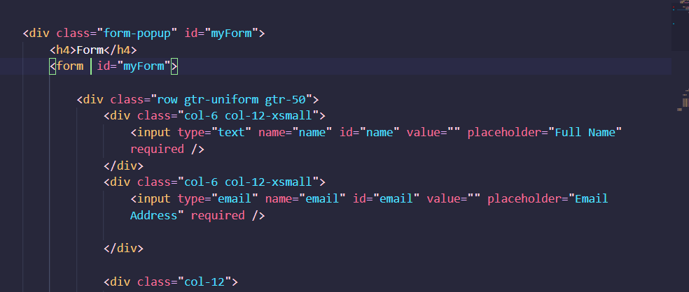
Form line in JavaScript
You’ll change your form line from this:

Slide 5
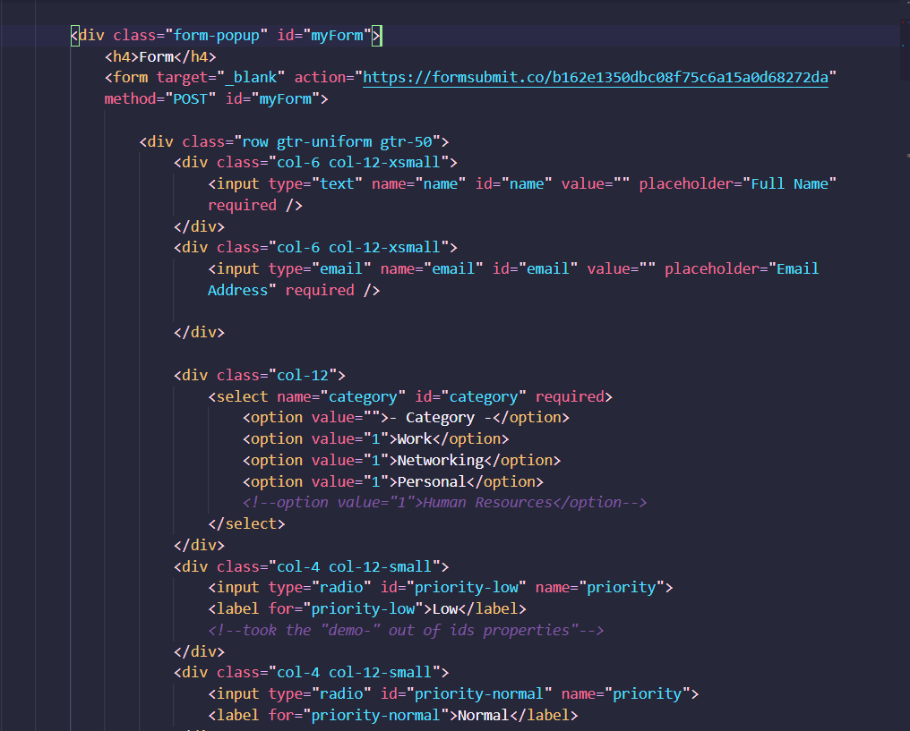
To this:
How?

Slide 6
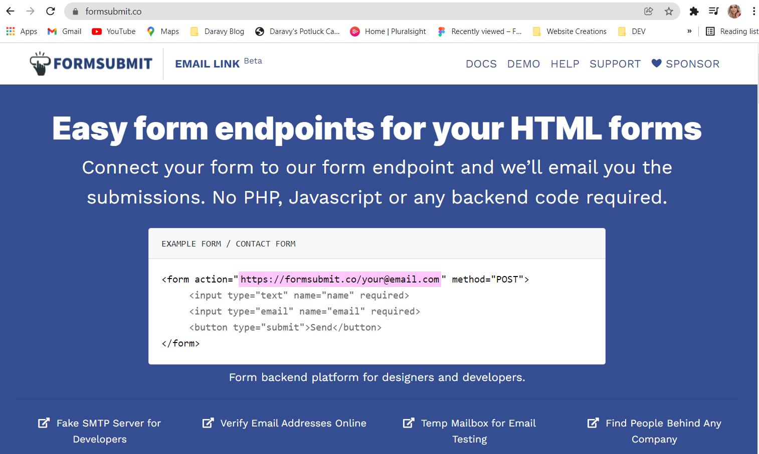
FORMSUBMIT.CO
This is how the site looks like, scroll all the way down until you see “Try it”

Slide 7
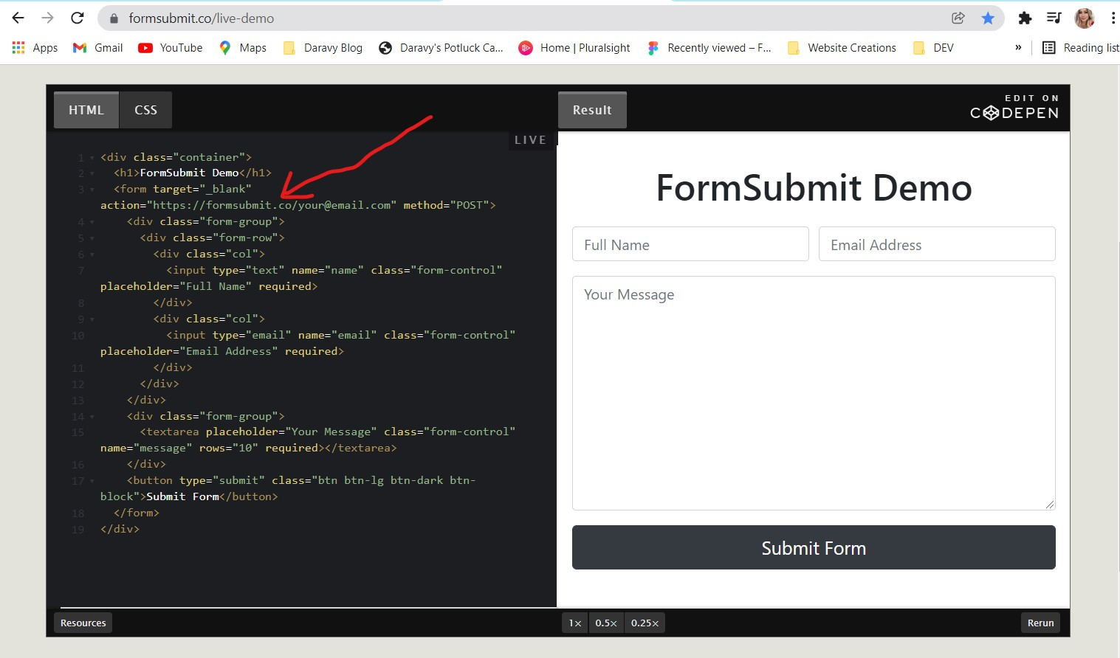
You should see this screen when you click that arrow.

Slide 8
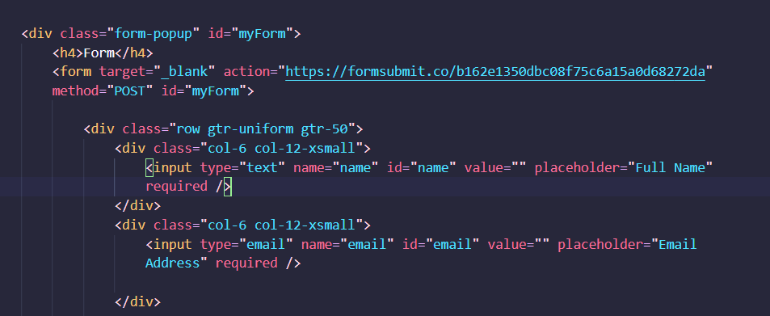
Back in JavaScript
Add the code from formsubmit.co

Slide 9
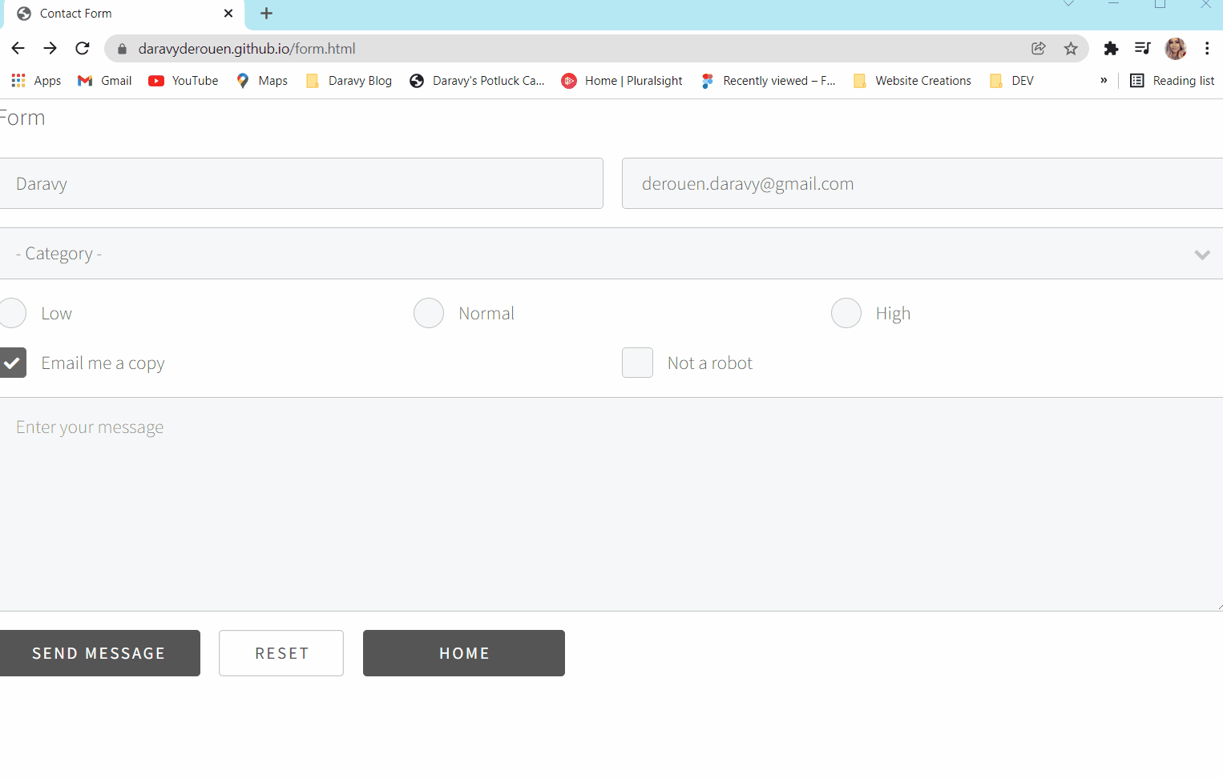
Testing!!!

Slide 10
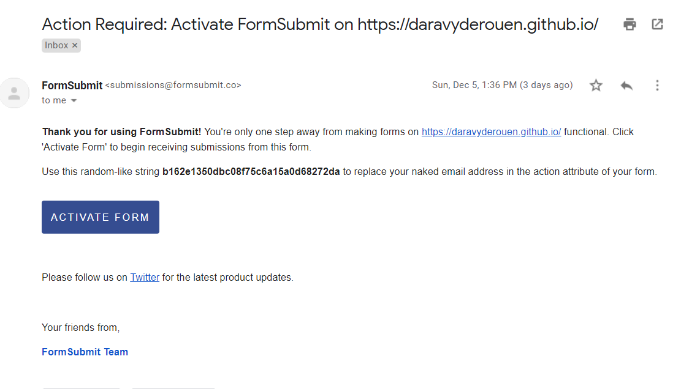
Email activation for contact form:
You should get an email from formsubmit.co once you made changes and updated your code
You can use the hash string formsubmit provides, but you must click “ACTIVATE FORM”
Your privacy matters! Use that hash!

Slide 11
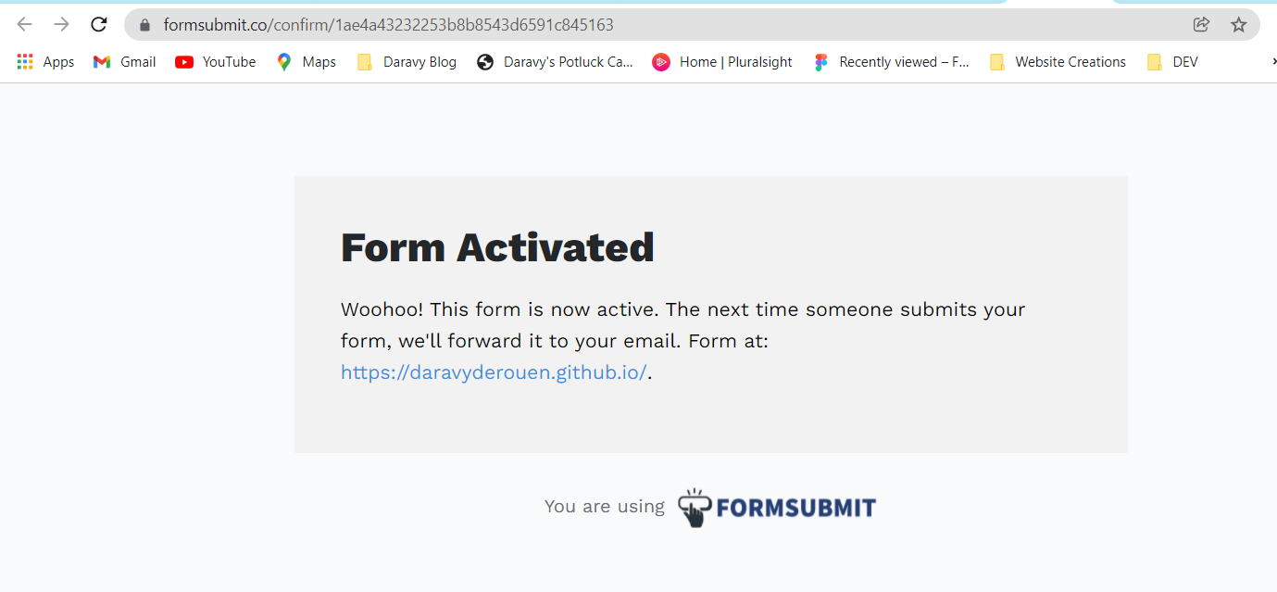
FORM IS LIVE & RESPONSIVE!

Slide 12
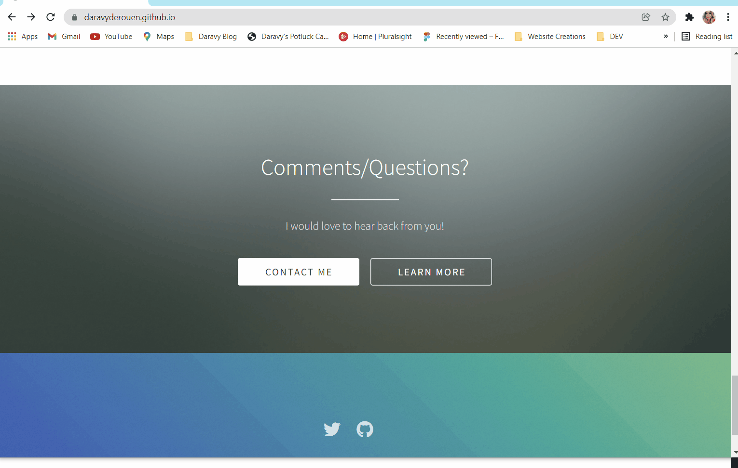

Slide 13
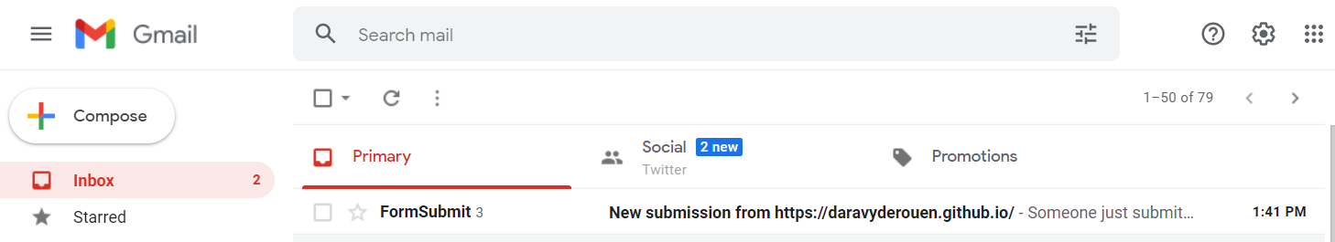
Go check your email!

Slide 14
The end!
Thanks for coming to my first, but not last, lighting talk!

